Slide 1
DEPARTMENT OF ELECTRICAL AND ELECTRONICS ENGINEERING
18EEP301L-MINOR PROJECT – II
Dual axis solar power tracking system
YEAR/ SEMESTER – II/IV
BATCH NUMBER :18
GUIDED BY:
Mr .S. DINESHKUMAR M.E., AP/EEE
PRESENTED BY:
POORVASANDHYA.P(927622BEE081)
PRAVEEN.M(927622BEE307)
SHARANYA.P(927622BEE105)
SRINITHI.K(927622BEE115)

Slide 2
LIST OF CONTENTS
Problem Statement
Objective
Abstract
Block Diagram
Cost Estimation
Survey form Analysis

Slide 3
PROBLEM STATEMENT
Generally, solar panels are stationary and do not follow the movement of the sun.
It only works in the presence of the sun light is strong .
The incident of sunlight changes or moves with the time of the day
It is used to tracks the sun movement across the sky and tries to maintain the solar panel perpendicular to sun rays, and ensuring that maximum number of solar light is incident on the solar plane

Slide 4

The main objective of the dual axis solar power tracking system is to follow the
Position of the sun for maximum energy efficiency.
To generate power from solar panel using dual axis tracker.
This helps better directivity with Sun rays, thus increasing the efficiency of the solar system.

Slide 5
ABSTRACT
As population is increasing globally, we are very concerned for Electricity.
There are various ways of electricity generation like Hydro power plant, Nuclear power plant, Windmill plants and also Solar power plants.
Nowadays we have lots of power plants established on Solar and Wind Technology.
Our project aims at Dual axis or Dual direction tracker.
The Solar panel used in this system can adjust its direction both in X-Y co-ordinates

Slide 6
DESCRIPTION
The dual axis tracker collect energy from the sun from the east west north and south angles.
It function on two axes primary and secondary.
One axis helps the solar tracker to move from east to west and the other helps the tracker to move from north to south.
Hence they are known as dual axis solar tracker. It can generate upto 40% more electricity than the unmovable solar panel systems that stay at a fixed position.
Besides due to its movement in all directions dual axis tracker is quite flexible.

Slide 7
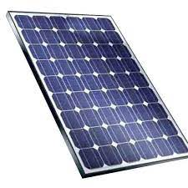
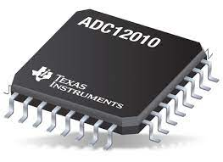
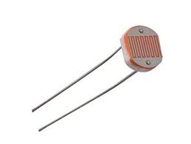
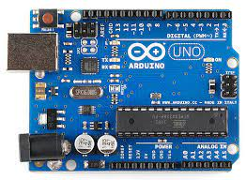
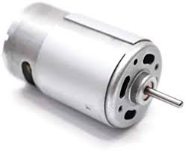
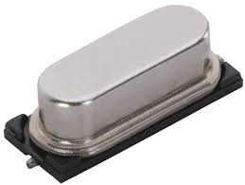
SOLAR PANAL
ADC
BLOCK DIAGRAM
ARDUINO
LDR
LDR
MOTOR
LDR
LDR
CRYSTALL OSCILLATOR

Slide 8
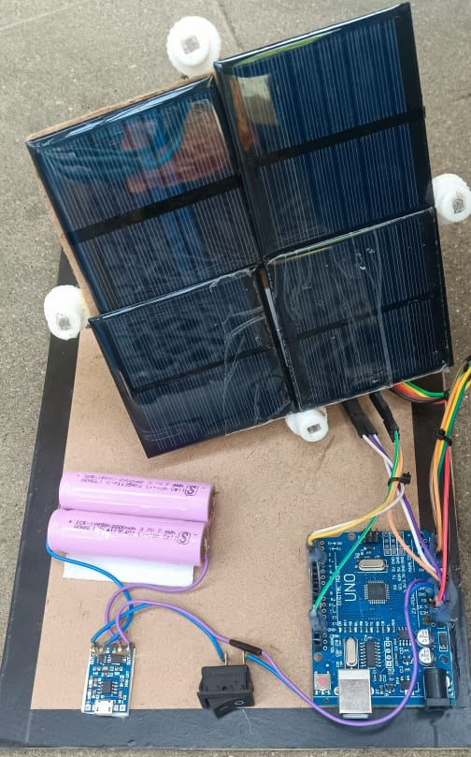

IMPLEMENTATION

Slide 9
SURVEY FORM ANALYSIS
1.SURVEYOR NAME:
P.Sathyakala
2.COMMUNITY PLACE:
Pandamangalam,
Kabilarmalai road,
pandamangalam.
3.PROBLEM IDENTIFICATION:
The production of rice flour is affected,because of powercut.

Slide 10
COST ESTIMATION
S.NO | COMPONENT DESCRIPTION | QUANTITY | COST
1 | Arduino UNO | 1 | Rs. 2,160
2 | LDR | 4 | Rs. 40
3 | MG995 Servo motor | 2 | Rs. 500
4 | Solar panel | 4 | Rs.240
5 | Bread board | 1 | Rs. 60
 |  | TOTAL | Rs. 3000

